Slide 1
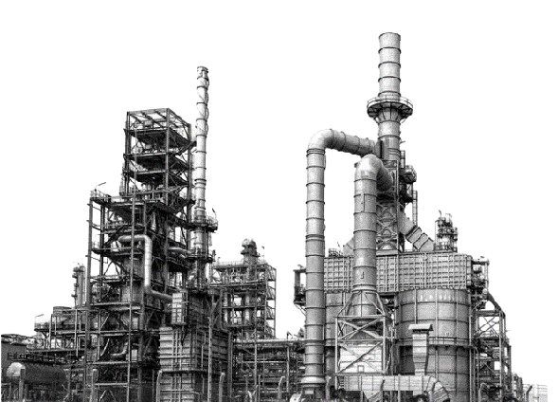
AI Powered Video Digest
Smart Online Video Summarization using Deep Learning and Generative AI
Sparsh Jaggi
VT20241264
NIT Raipur , IT , 3rd year
Anisha Dutta
Analyst , TSM, Tata Steel Limited
Moromee Das
Head , TSM, Tata Steel Limited
13 May – 29 June 2024

Slide 2
LEARNING CURVE :
Google Colab Environment
Computer Vision - OpenCV
Object Detection - Yolo
Augmentation - Keras CV
GenAI Image Generation –Stable Diffusion
Web Video Download - PyTube Video Data Handling – OpenCV
Face Analysis – OpenCV Cascade, DeepFace Open Source LLM Query

Slide 3
INTRODUCTION
Video Extraction: Used Pytube to source diverse video content from YouTube.
Object Detection: Applied YOLO (You Only Look Once) algorithm for accurate identification
and segmentation of key objects and scenes.
Summarization: Utilized Gemini LLM (Large Language Model) for generating meaningful and
concise summaries with enhanced contextual understanding.
Platform: Managed and executed the entire workflow on Google Colab.
Technologies: Combined deep learning, computer vision, and generative AI for automated and
sophisticated video summarization.

Slide 4


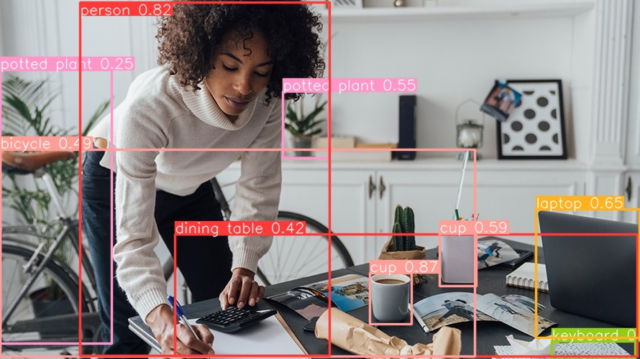





PROJECT FLOW
Extracting Frames
INPUT URL

Slide 5
CONCLUSION :
In this project, we successfully developed a comprehensive pipeline for video summarization and facial analysis by integrating several advanced technologies and tools.
Key Learnings and Outcomes :
Integration of Multiple Technologies
Enhanced Video Summarization
Advanced Facial Analysis
Real-time Processing Capability
Scalability and Flexibility

Slide 6


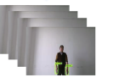
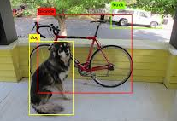
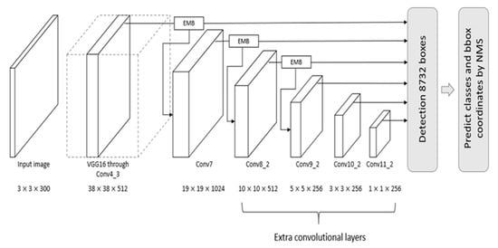
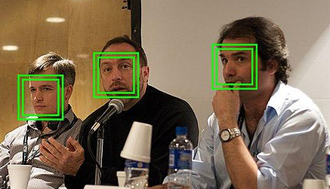
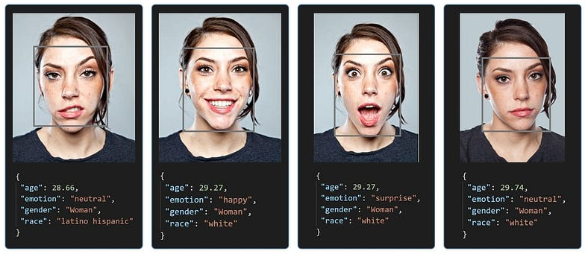

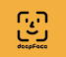
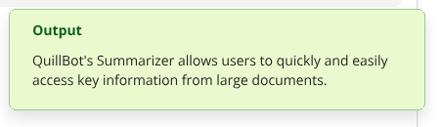
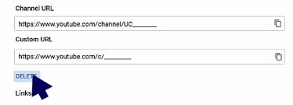
Further Scope with other learnings
Input URL
Output Summary

